Slide 1
Flood Risk Prediction (Week 6)
Data Analytics Internship Project
GNCIPL
Presented by
Yogeshwaran N
Soumyadeep Bhattacharyya
Ramkrishna Ghosh

Slide 2
Introduction
Floods cause severe damage to life, infrastructure and economy.
This project predicts flood risk using rainfall, river level and GIS data.
End-to-end pipeline from data collection to dashboard visualization.

Slide 3
Objectives
Analyze historical rainfall & river data
Predict flood occurrence & severity
Identify high-risk flood zones
Develop interactive monitoring dashboard

Slide 4
Data Sources
Rainfall & river gauge data
Meteorological parameters
Topography & elevation
Land use & soil texture
Urban & population indicators

Slide 5
Tools & Technologies
R – Data cleaning
Python – ETL, EDA & ML modeling
GIS Libraries – Spatial analysis
Tableau – Interactive dashboards

Slide 6
Methodology
ETL & data integration
Data cleaning & preprocessing
Feature engineering
EDA & GIS analysis
Machine learning modelling
Dashboard making in Tableau

Slide 7
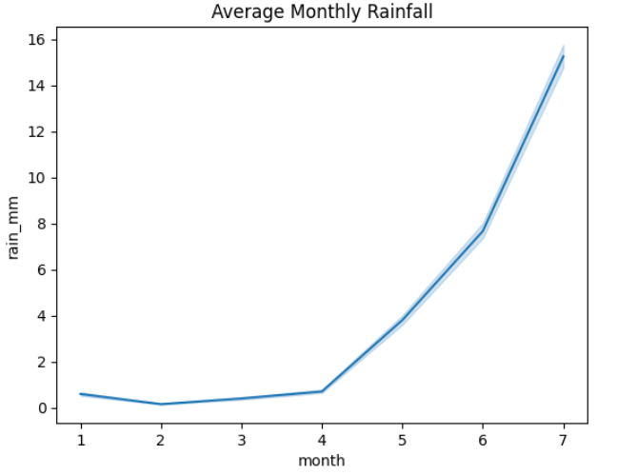
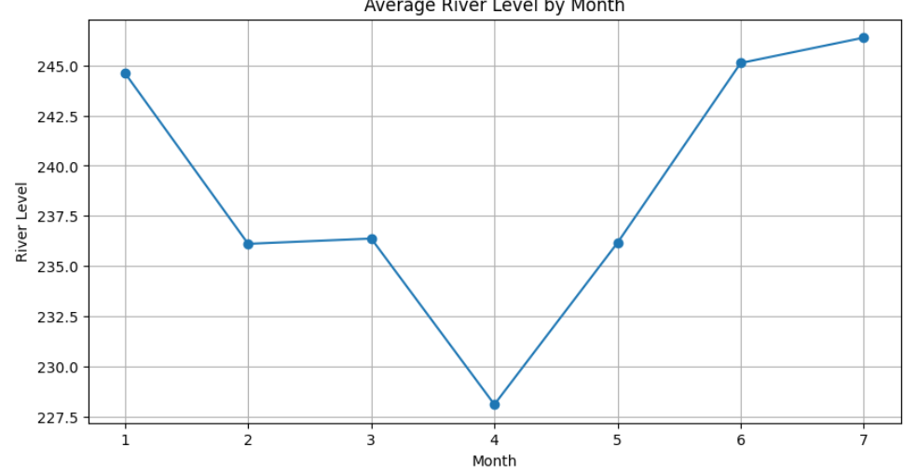
Exploratory Data Analysis
Rainfall over month Monthly river level trend

Slide 8
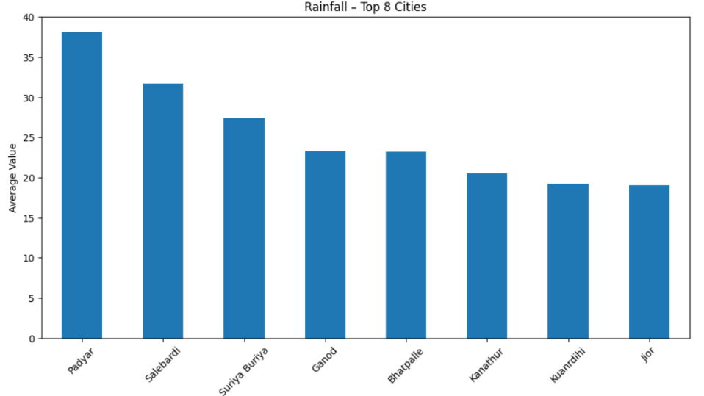
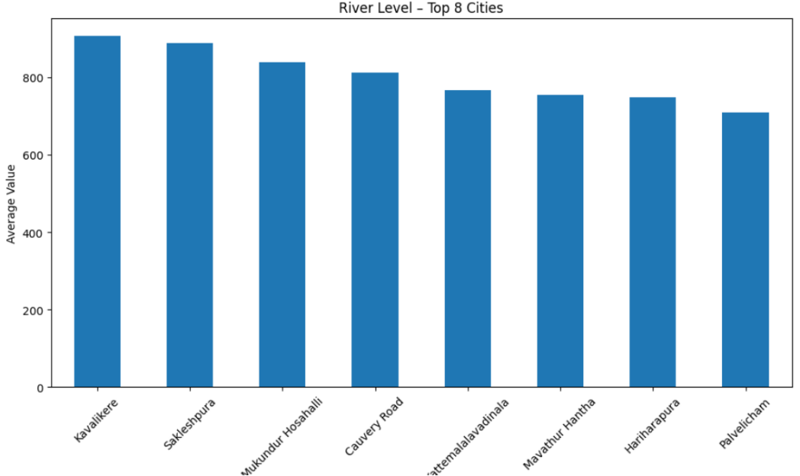
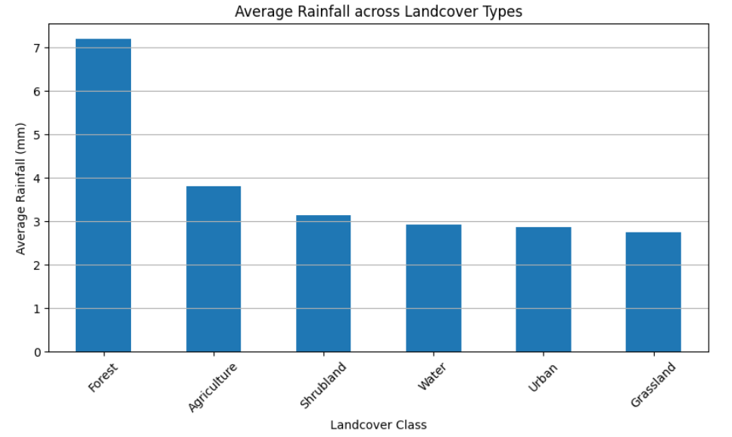
Top 8 cities based on both rainfall & river level
Avg Rainfall over Land class

Slide 9
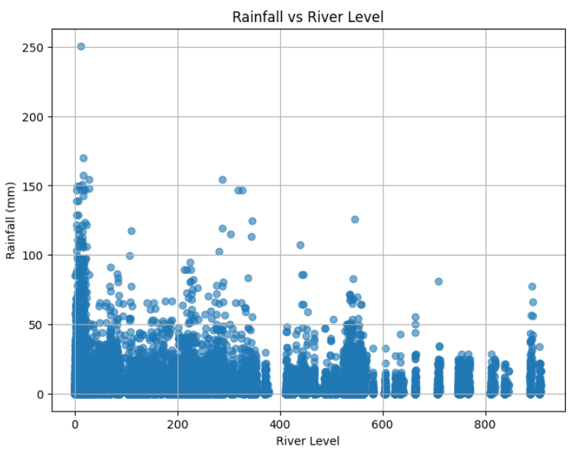
Top 8 Cities comparing Rainfall & River level

Slide 10
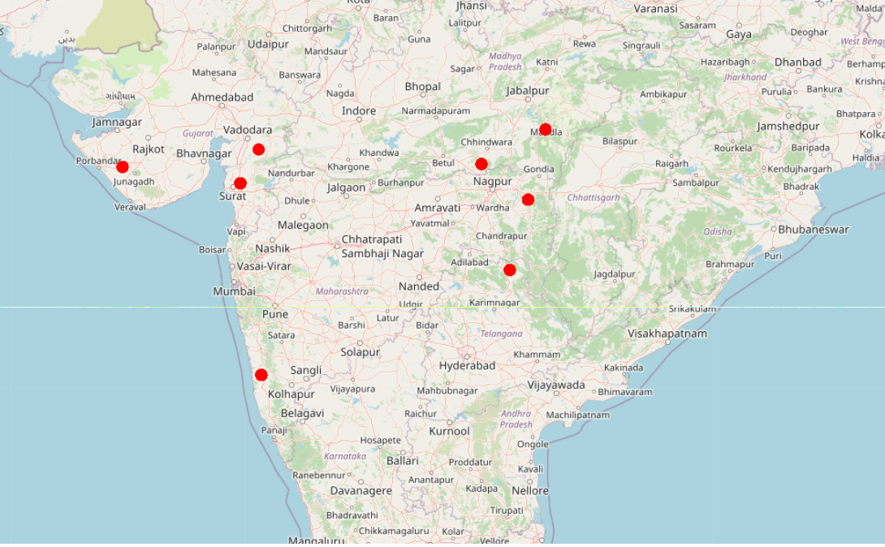
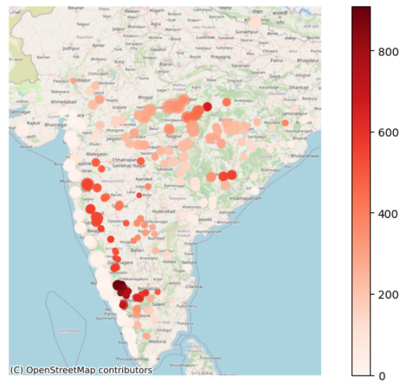
Spatial Analysis and GIS Mapping

Slide 11
Feature Engineering
Log transformation
Lag & rolling window features
Urbanization indicators
Temporal features & encoding
Train-test temporal split

Slide 12
Machine Learning Models
XGBoost regression models
River level & flow rate prediction
High accuracy with R² up to 0.998
Severity score-based risk classification

Slide 13
Dashboard & Visualization
Tableau KPIs & flood trends
City-wise & temporal analysis
GIS-based flood risk maps
User-friendly filters

Slide 14
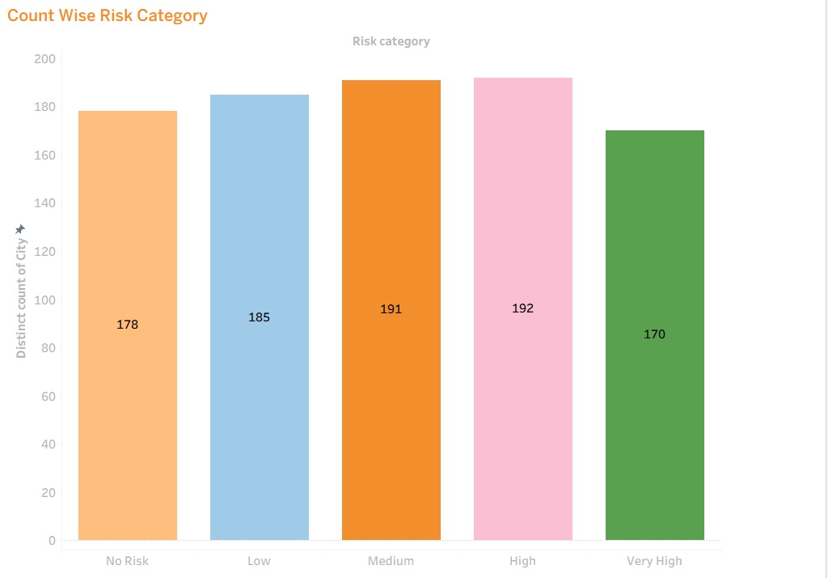
Count Wise Risk Category

Slide 15
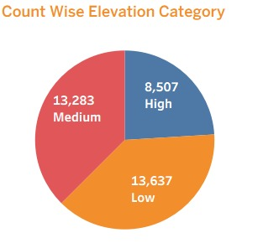
Count Wise Elevation Category

Slide 16
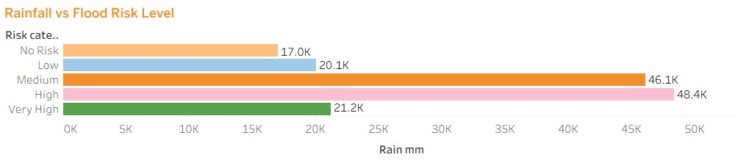
Rainfall vs Flood Risk Level

Slide 17
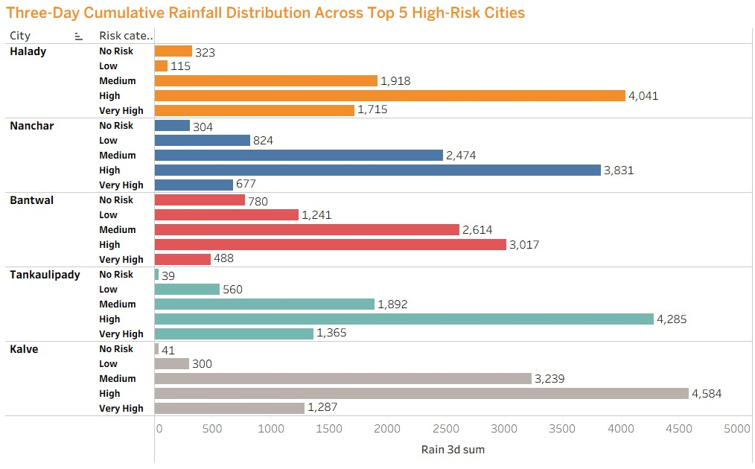
Three-Day Cumulative Rainfall Distribution Across Top 5 High-Risk Cities

Slide 18
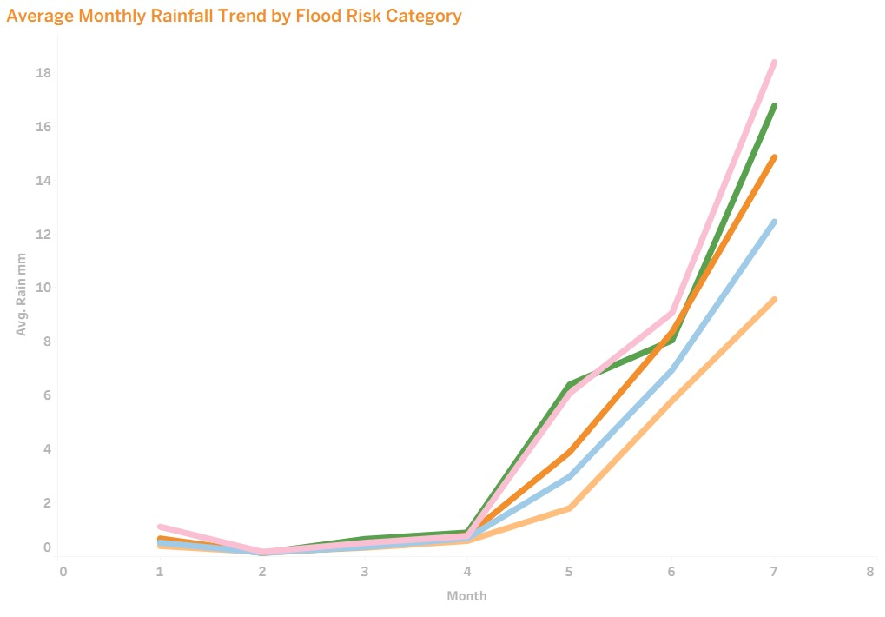
Average Monthly Rainfall Trend by Flood Risk Category

Slide 19
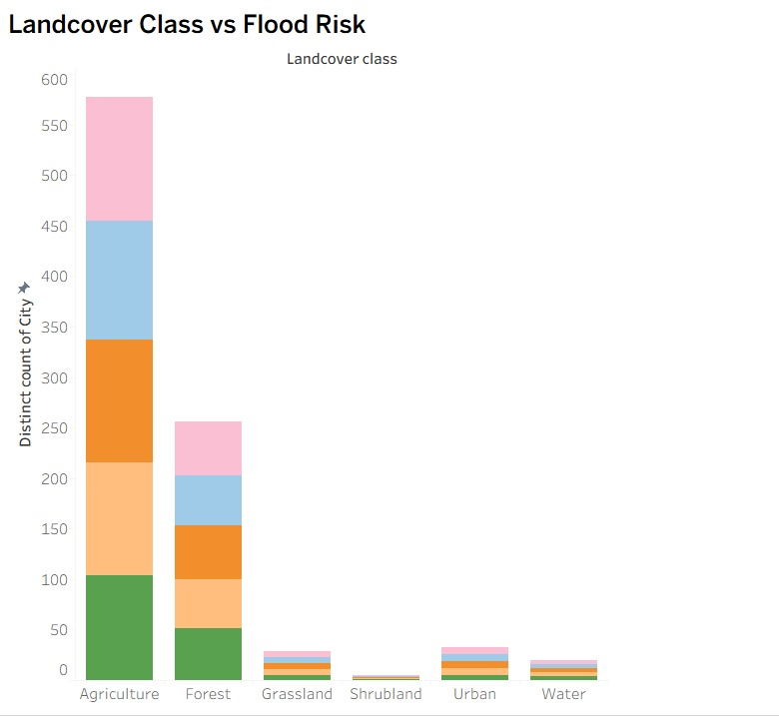
Landcover Class vs Flood Risk

Slide 20
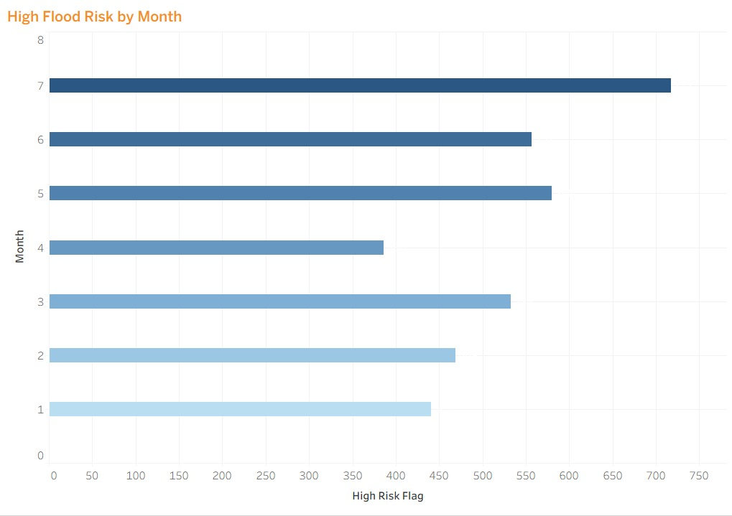
High Flood Risk by Month

Slide 21
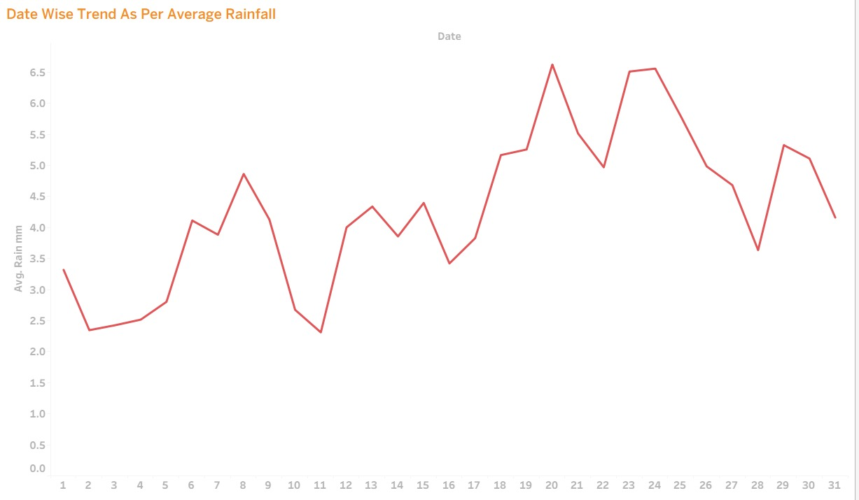
Date Wise Trend As Per Average Rainfall

Slide 22
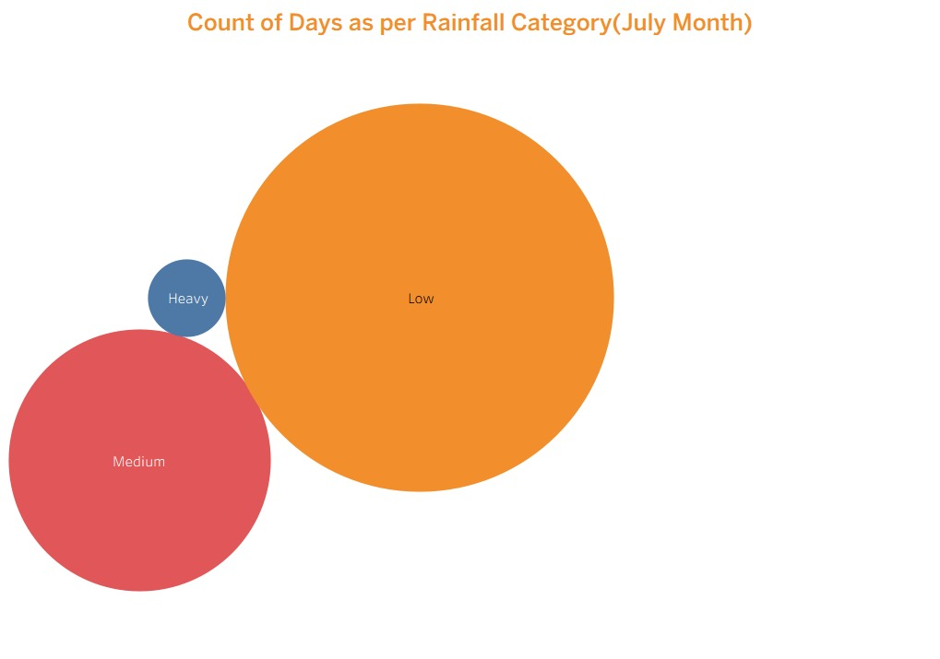
Count of Days as per Rainfall Category(July Month)

Slide 23
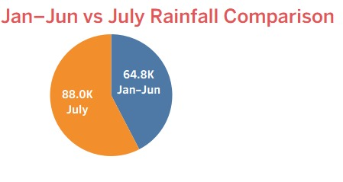
Jan–Jun vs July Rainfall Comparison

Slide 24
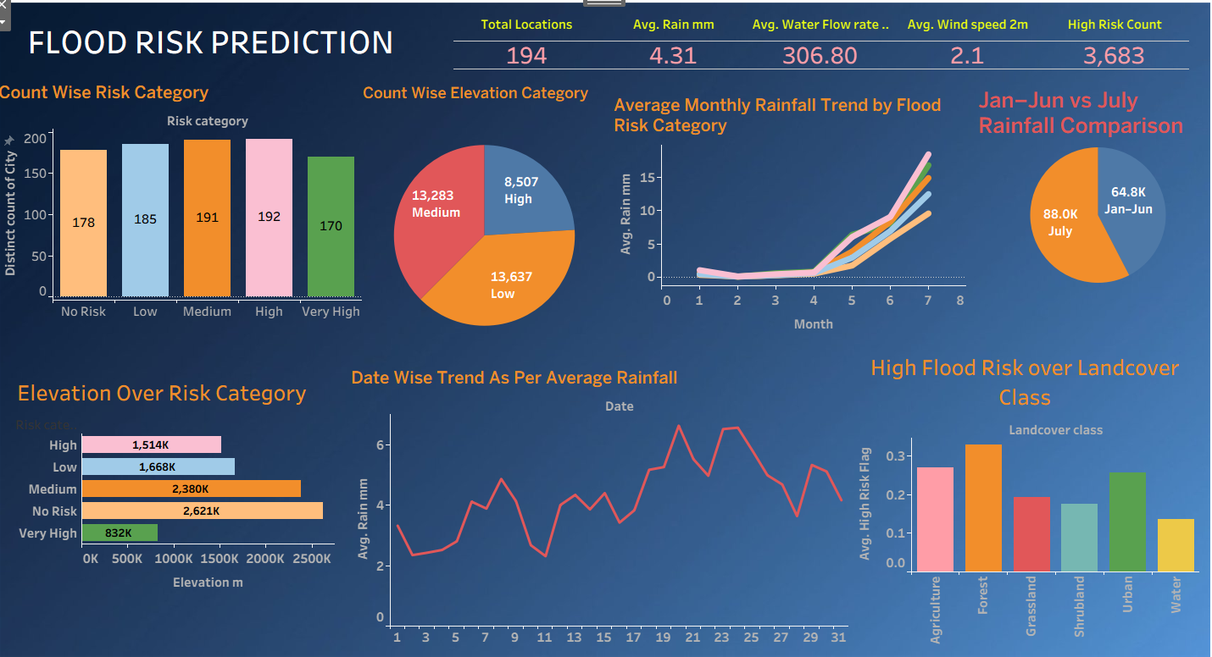
Dashboard

Slide 25
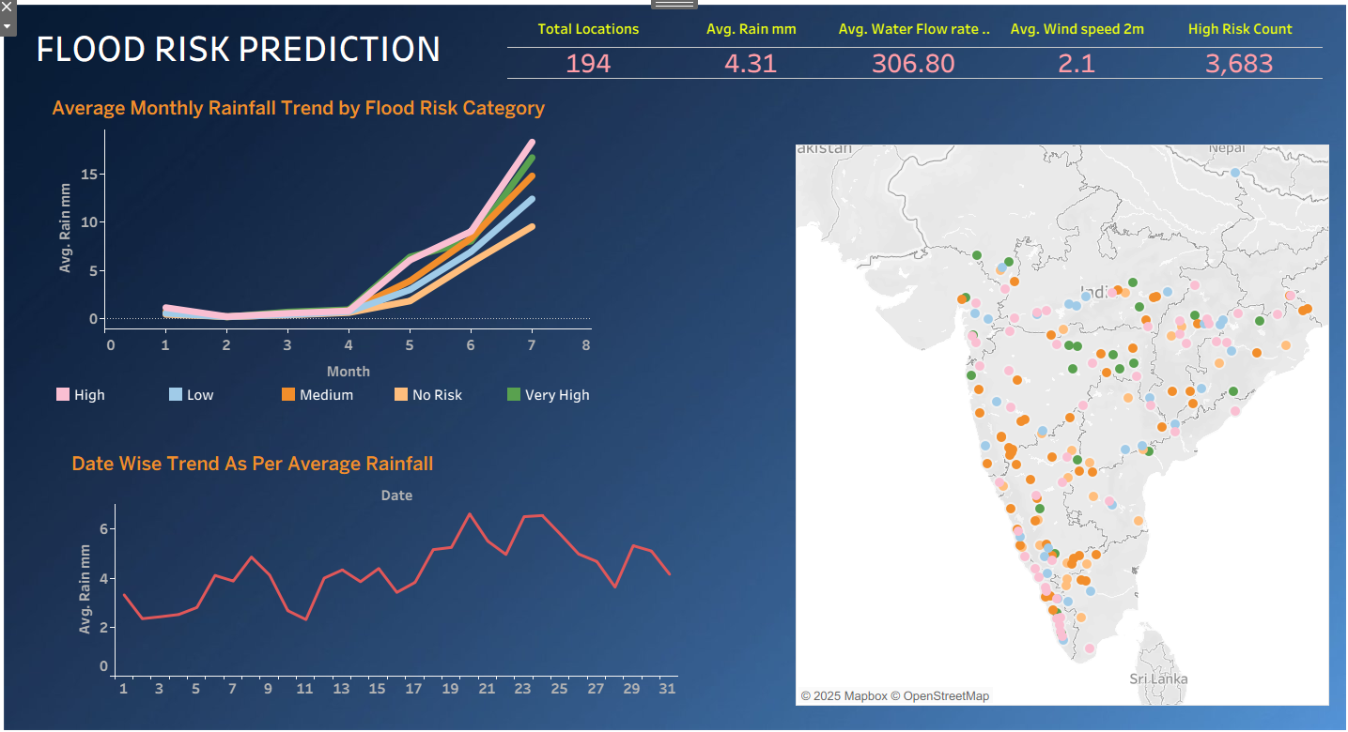
Dashboard

Slide 26
Key Insights
1️⃣ Flood Risk Category Distribution
The number of High (192) and Medium (191) risk locations is the highest.
Although Very High risk (170) locations are fewer in number, they represent the most critical zones.
Insight: A large portion of the study area falls under moderate to high flood vulnerability.

Slide 27
Key Insights
2️⃣ Elevation vs Flood Risk
High and Very High flood risk areas are mostly located at lower elevations (≈ 832K–1,514K meters).
No Risk and Medium Risk zones have comparatively higher average elevation.
Insight: Low-lying regions are significantly more prone to flooding.

Slide 28
Key Insights
3️⃣ Monthly Rainfall Trend by Risk Category
Rainfall shows a sharp increase from May to July across all risk categories.
Peak rainfall occurs during June–July, which strongly correlates with higher flood risk.
Insight: The monsoon season is the primary trigger for flood events.

Slide 29
Key Insights
4️⃣ Jan–Jun vs July Rainfall Comparison
July alone records ~88K mm rainfall, while January–June together account for ~64.8K mm.
Insight: A single month contributes more rainfall than the first six months combined, increasing the likelihood of flash floods

Slide 30
Key Insights
5️⃣ Impact of Landcover on Flood Risk
Forest and agricultural areas show the highest probability of high flood risk.
Urban areas also demonstrate significant risk due to drainage congestion and surface runoff.
Water bodies exhibit relatively lower high-risk probability.
Insight: Landcover type plays a crucial role in determining flood severity

Slide 31
Key Insights
6️⃣ Date-wise Rainfall Variability
The daily rainfall trend displays frequent spikes and fluctuations.
Sudden increases indicate a higher chance of short-duration flood events.
Insight: Continuous monitoring is essential for timely flood prediction.

Slide 32
RECOMMENDATIONS
✅ 1. Early Warning and Monitoring Systems
Implement real-time rainfall and water flow monitoring, especially during May–July.
Deploy automated flood alerts in High and Very High risk zones.

Slide 33
RECOMMENDATIONS
✅ 2. Infrastructure Development
Focus on low-elevation, high-risk areas by improving:
  Drainage systems
  River embankments
  Rainwater diversion channels
Priority should be given to urban and agricultural regions.

Slide 34
RECOMMENDATIONS
✅ 3. Land Use and Environmental Management
Regulate deforestation in forest and agricultural zones.
Promote flood-resistant crops and sustainable land management practices.
Restrict unplanned construction in flood-prone areas.

Slide 35
RECOMMENDATIONS
✅ 4. Disaster Preparedness and Policy Planning
Develop district-wise flood preparedness plans for the month of July.
Establish:
  Emergency shelters
  Evacuation routes
  Community awareness and training programs

Slide 36
RECOMMENDATIONS
✅ 5. Data Enhancement for Better Prediction
Future models can be improved by including:
  Water depth
  Soil moisture levels
  River discharge data
This will enhance prediction accuracy and reliability.

Slide 37
Results & Findings
Strong relationship between rainfall & river level
ML models provide reliable predictions
Spatial analysis highlights flood hotspots

Slide 38
Challenges
Multi-source data integration
Handling noisy real-world data
Dynamic weather patterns

Slide 39
Conclusion
End-to-end flood risk prediction system
Combines analytics, ML, GIS & dashboards
Supports disaster preparedness & planning

